Slide 1
Customer And Sales Presentation
Dashboard presentation with screenshots
Gmail – shubbharti001@gmail.com
By Shubham Bharti

Slide 2
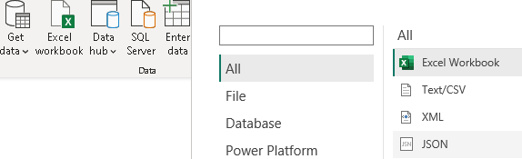
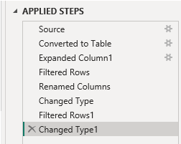
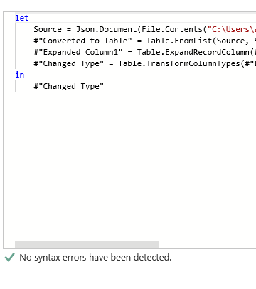
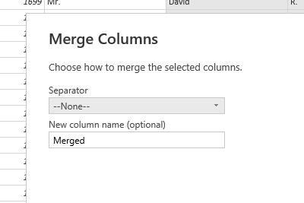

Slide 3
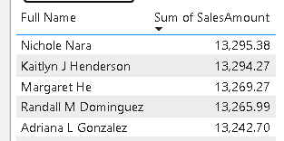

Top 5 Names With Highest Number Of Sales
Product Category With Highest Sales

Slide 4
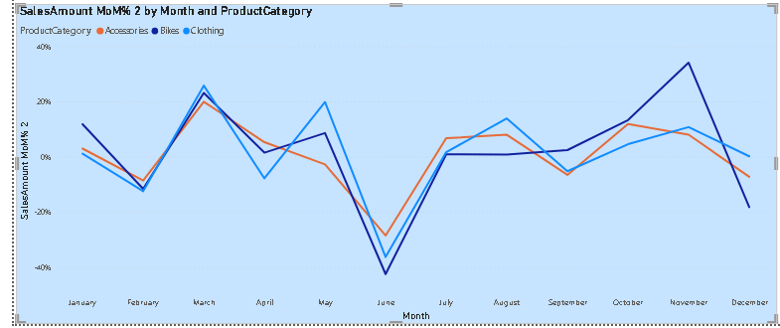
Month Over Month Sales

Slide 5
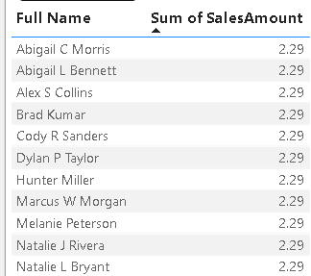

There Are 11 People With Minimum Amount Of Sales
Nichole Nara Has The Highest Amount Of Sales

Slide 6
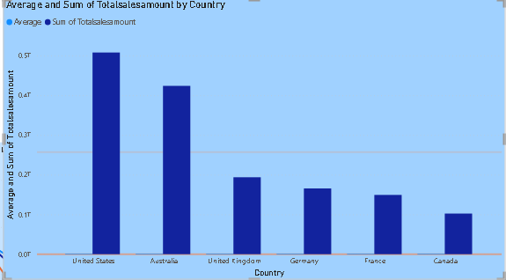

Slide 7
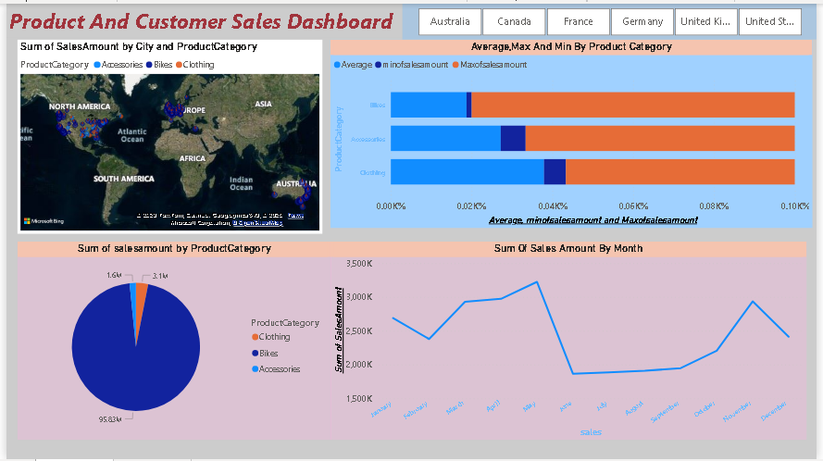

Slide 8
Here is The Link of Internship project
https://drive.google.com/file/d/1g9dent9e0PUIuGY1SXinw1Vb_IOesjWd/view?usp=share_link
THANK YOU SIR

